Slide 1
Sign language to Text Conversion
Group 8
Aniket Gupta
Nitish Kumar M
Sagnik Roy
Siddhant Setia
Umang Singhal

Slide 2
Introduction
Everyone deserves to have their voice heard, no matter the circumstances. With this being said, sign language is a two-way street. The deaf community needs to know it, along with everyone else around them. They must live in an environment and world that they feel can hear them and what they are trying to say at all times, and to all walks of life.
Deaf and mute people make use of their hands to express different gestures to express their ideas with other people. Gestures are the nonverbally exchanged messages and these gestures are understood with vision. This nonverbal communication of deaf and dumb people is called sign language.
In our project, we focus on producing a model which can recognise hand gestures in order to form a complete word by combining gestures for each alphabet potrayed by the user.

Slide 3
Business Problem
The importance of sign language is gaining momentum, finally, and it is evident more people are seeing the need for it in today’s society. No one should be left in the dark, no matter what disabilities they may have. Also, it is an everlasting skill that can without a doubt make people more well-rounded. Learning the skill of sign language can also show the deaf community that they are not being forgotten, and they have the same access to communication with the rest of the world as anyone else, and that their voices should never be muted or disregarded.
Reliable estimates for American ASL users range from 250,000 to 500,000 persons, including a number of children of deaf adults.
The aim is to develop a user-friendly human computer interface (HCI) where the computer understands the human sign language.

Slide 4
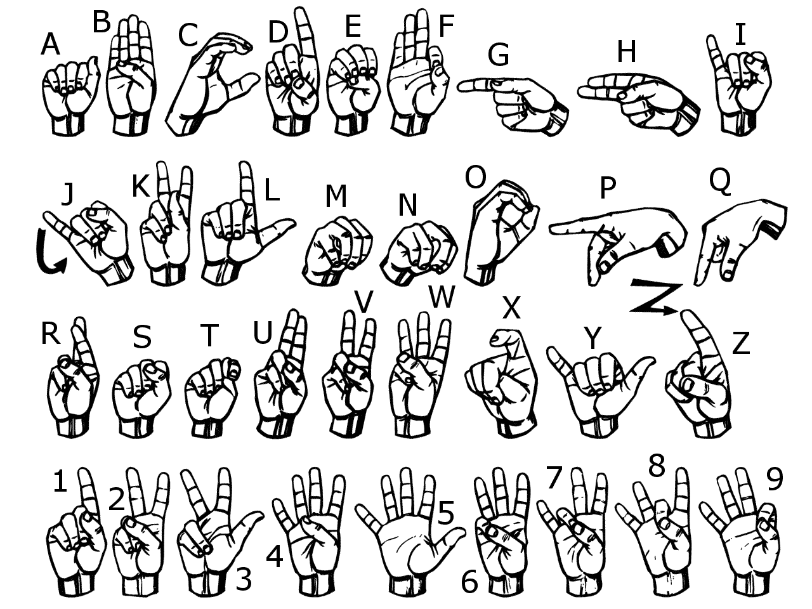
Dataset
The Dataset was created on our own for training and testing.
We used the Open computer vision(OpenCV) library in order to produce our dataset. Firstly we captured around 800 images of each of the symbols in ASL for training purposes and around 200 images per symbol for testing purposes.

Slide 5
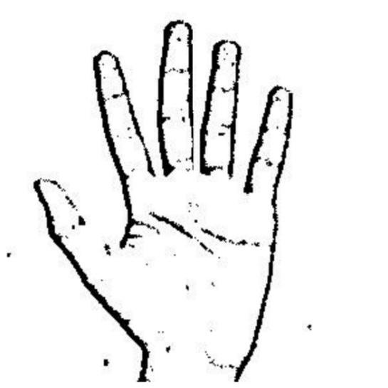
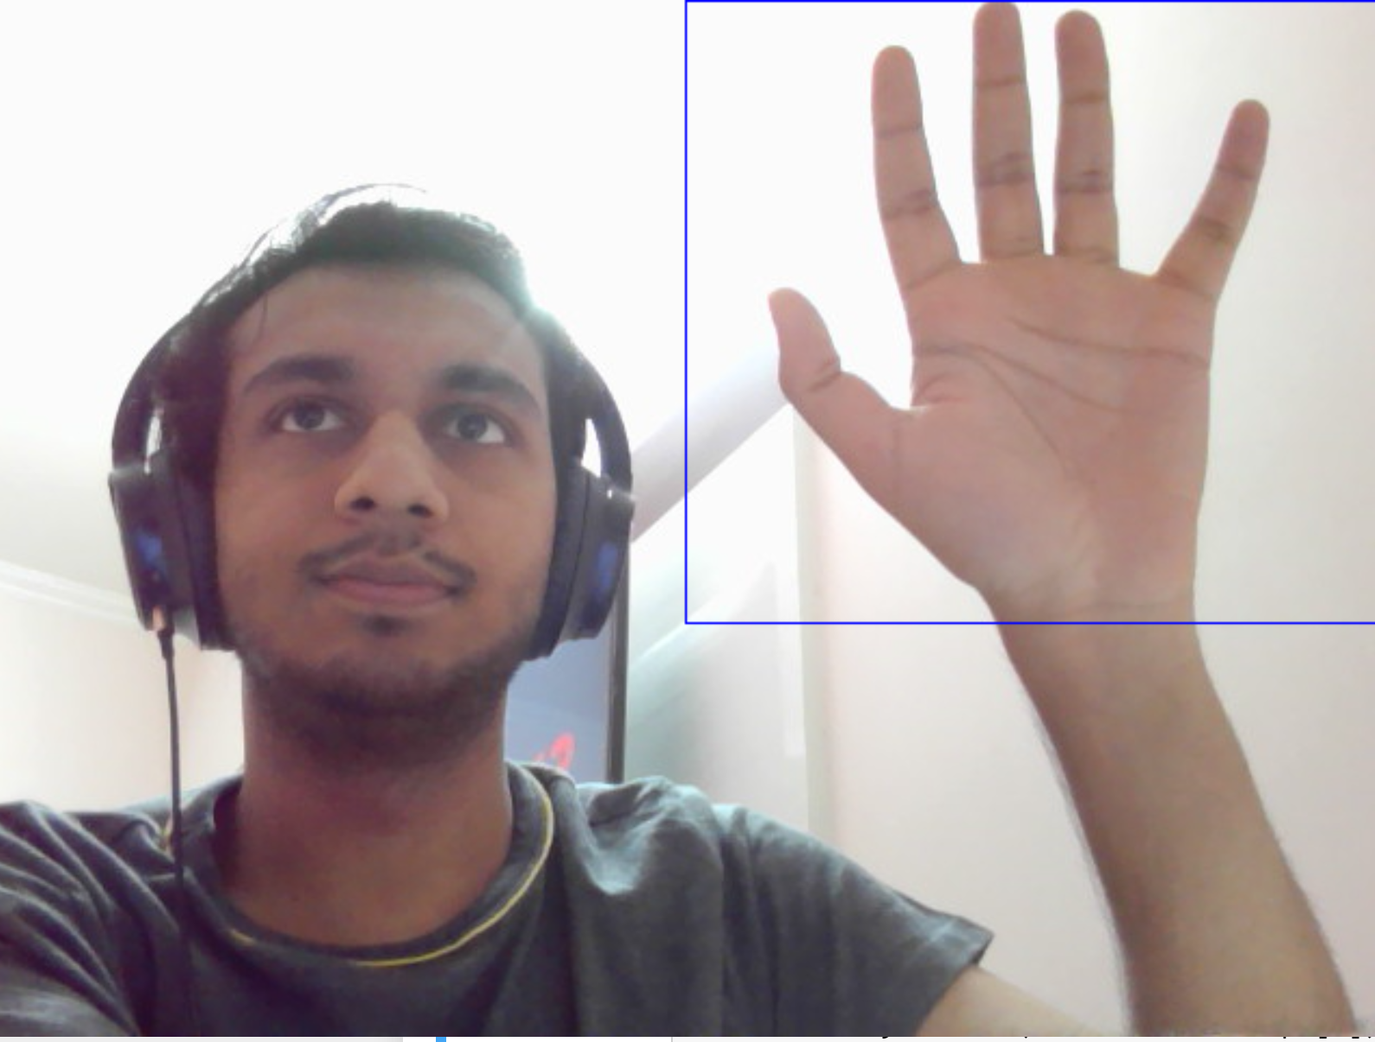
Dataset Generation
Capturing Raw Image Image After Preprocessing

Slide 6
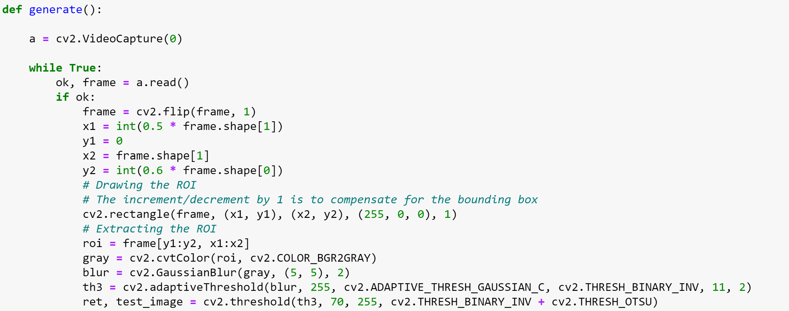
Code Snippet….

Slide 7
Gesture Classification
Our approach uses two layers to predict the final symbol of the user.
Layer1:
1. Apply gaussian blur filter and threshold to the frame taken with opencv to get the processed image after feature extraction.
2. This processed image is passed to the CNN model for prediction and if a letter is detected for more than 50 frames then the letter is printed and taken into consideration for forming the word.
3. Space between the words are considered using the blank symbol.

Slide 8
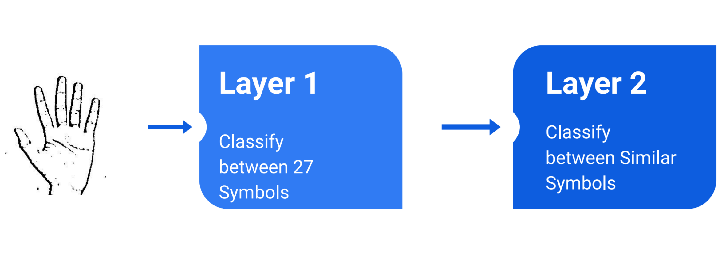
Layer 2:
1. We detect various sets of symbols which show similar results on getting detected.
2. We then classify between those sets using classifiers made for those sets only.
In our testing we found that following symbols were not showing properly and were giving other symbols also : 1. 1. For D : R and U
2. For I : T, D, K
3. For S : M and N

Slide 9
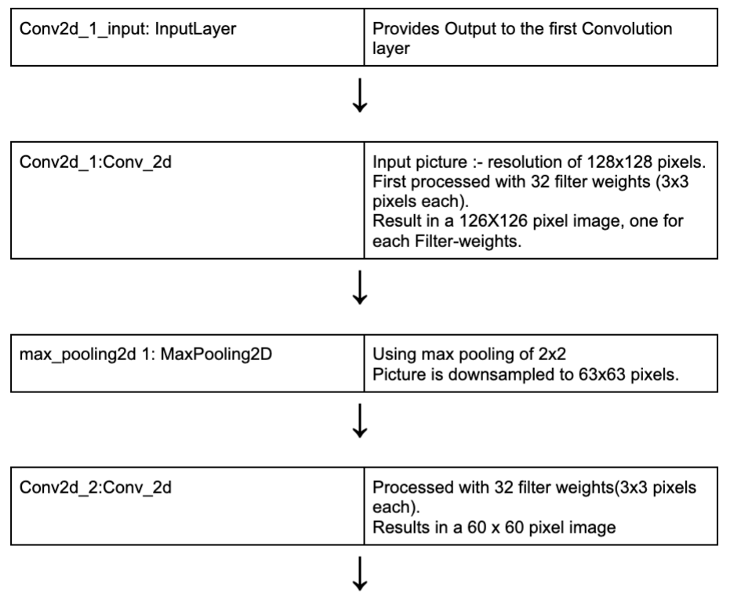
Neural Network Design (CNN)

Slide 10
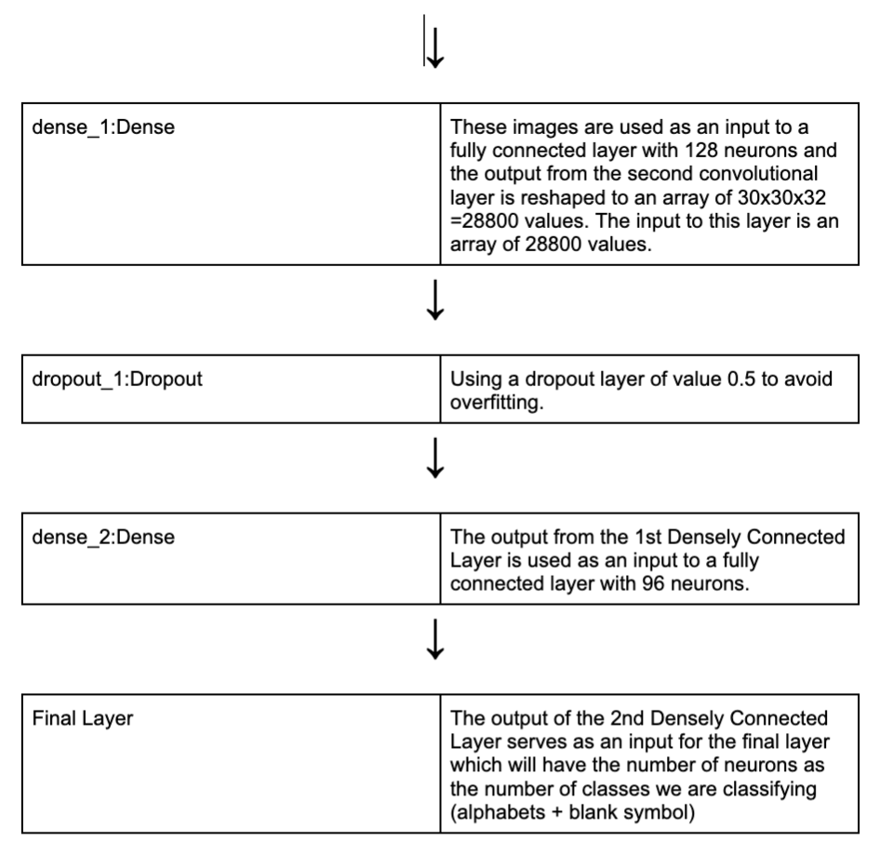

Slide 11
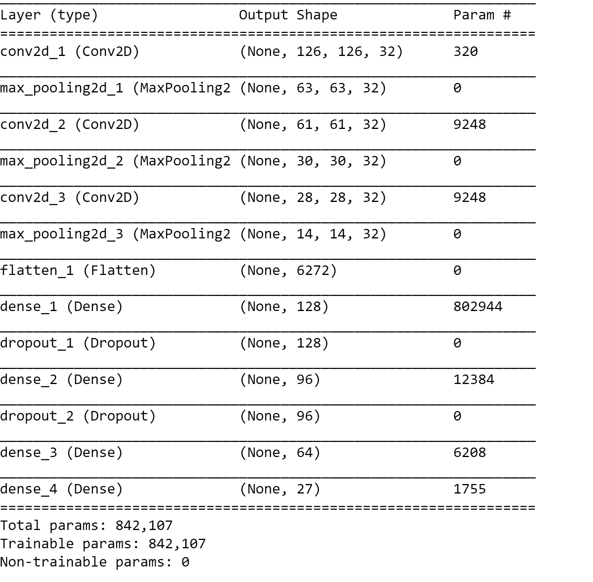

Slide 12
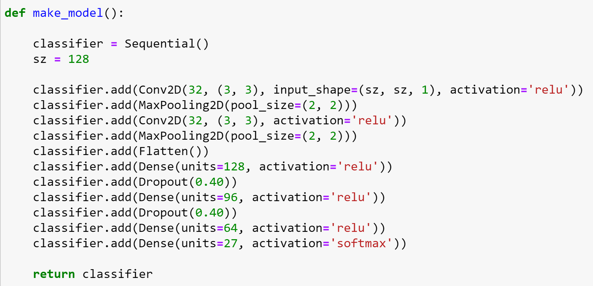
Code Snippet….

Slide 13
Prediction
Whenever the count of a letter detected exceeds a specific value and no other letter is close to it by a threshold we print the letter and add it to the current string (In our code we kept the value as 50 and difference threshold as 20).
Otherwise we clear the current dictionary which has the count of detections of present symbol to avoid the probability of a wrong letter getting predicted.
Whenever the count of a blank (plain background) detected exceeds a specific value and if the current buffer is empty no spaces are detected.
In other case it predicts the end of word by printing a space and the current gets appended to the sentence below.

Slide 14
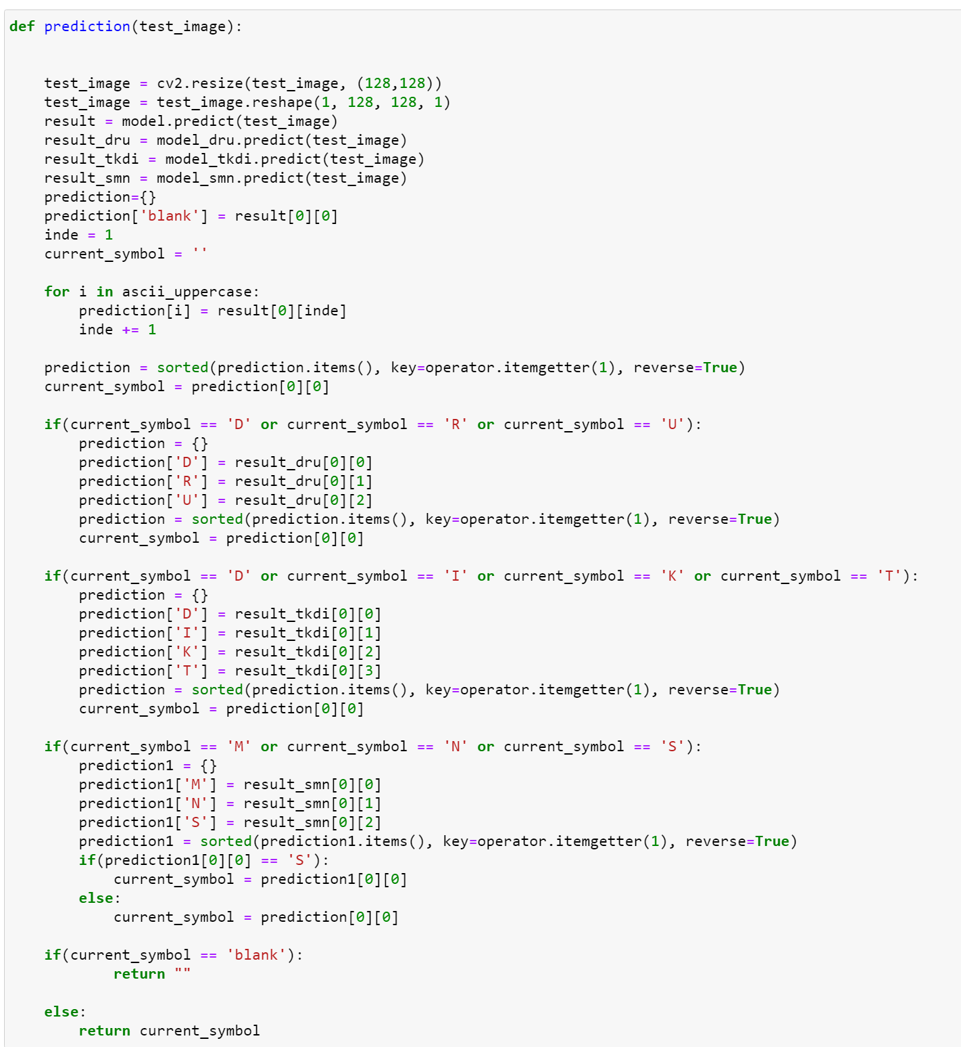
Code Snippet….

Slide 15
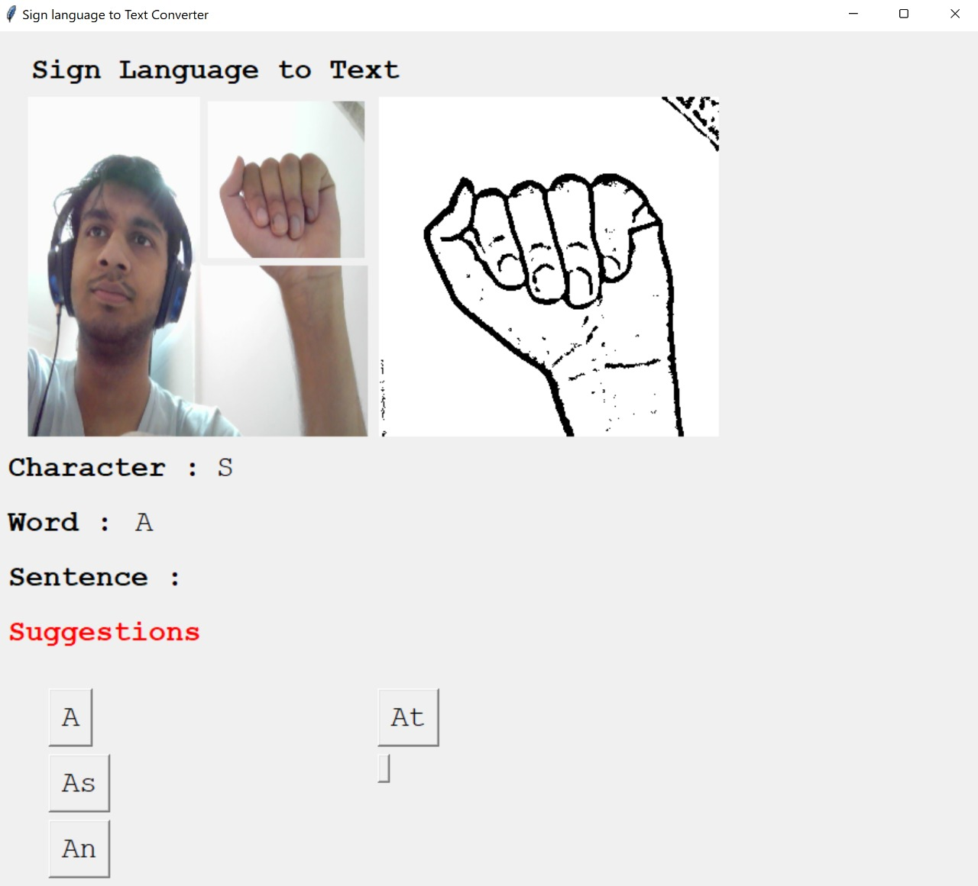
Demo and GUI

Slide 16
Suggestion Feature and GUI
A python library pyEnchant is used to suggest which the user can select to append to the current sentence. This helps in reducing spelling errors, assists in predicting complex words and significantly reduces the time taken for prediction.
For GUI, Tkinter library was used

Slide 17
Challenges Faced
We couldn’t find an appropriate dataset with raw images of all the ASL characters so we made our own dataset.
Selecting a filter for feature extraction : We tried various filter including binary threshold, canny edge detection, gaussian blur etc. ,of which gaussian blur filter was giving better results.
Issues were faced relating to the accuracy of the model we trained in earlier phases which we eventually improved by increasing the input image size and also by altering the model structure and adding extra models for similar aplhabets.

Slide 18
Limitations and Future Enhancements
With GPUs and machines with more computational power, the speed of predicitions and accuracy of the model can be improved.
The suggestion feature through pyEnchant library doesn’t give the best suggestions at times and it would be much better if we could add our own NLP model for autocorrect, suggestions and autocomplete.
Our model doesn’t track the position of hands and the user must make the hand gestures in a specific location of the screen. Hand detection and tracking can be added to make the model better.
The model requires a clear and clean background for accurate and fast predictions. This might not always be possible to create.
The model could be deployed as a mobile app or web app in the future to make it more accessible to all.

Slide 19
Conclusion
In this project, a functional real time vision based american sign language recognition has been developed for ASL alphabets.
Any user can access the program and sit in front of the camera. They can make symbols of American Sign Language (ASL). The system will simultaneously show the corresponding English text.
We achieved final accuracy of 95% on our dataset. We are able to improve our prediction after implementing two layers of algorithms in which we verify and predict symbols which are more similar to each other.
This way we are able to detect almost all the symbols provided that they are shown properly, there is no noise in the background and lighting is adequate.

Slide 20
THANK YOU ☺

